Slide 1


APLICAÇÃO DE TÉCNICAS DE INTELIGÊNCIA ARTIFICIAL EM DADOS DE ESPECTROMETRIA DE MASSAS E CRIAÇÃO DE UMA FERRAMENTA GENÉRICA PARA ANÁLISE E CLASSIFICAÇÃO DE DADOS DE ESPECTROMETRIA DE MASSAS
Orientador: Dr. Roberto Tadeu Raittz.
Co-orientador: Dr. Luciano F. Huergo.
Mestrando: Calebe Elias Ribeiro Brim.
PROGRAMA DE PÓS GRADUAÇÃO EM BIOINFORMÁTICA
Notes:
Bom dia a todos, Meu nome é Calebe Brim e eu sou baicharel em Sistemas de informação pela UNIVILLE - Universidade da região de joinville. Gostaria de comprimentar a banca:
Professor Dr. Luiz Melo Romão.
Professor Dr. Paulo Costa Carvalho.
Professora Dr. Geisa Caprini
E venho por meio desta apresentação defender o título de mestre pelo programa de pós graduação em bioinformática da UFPR e apresentar a concusão do projeto de pesquisa "citar o título".
Este projeto foi desenvolvido sob orientação do Professor Doutor Roberto Tadeu Raittz e coorientação do Professor Luciano Huergo.
Este trabalho tem como objetivo estudar tecnicas de inteligência artificial aplicadas a dados de espectrometria de massas de uma forma genérica; e desenvolver uma ferramenta que permita o usuário realizar a tarefa de classificação sem a necessidade de conhecimentos de programação.
----- Meeting Notes (7/22/15 19:53) -----
Alteração de Título: ML-MS: uma ferramenta para análise e classificação de proteinas.
Uma ferramenta de inteligência artificial

Slide 2
Introduction
Bioinformatics
Genomics
Proteomics
Notes:
Para entender os objetivos gerais e específicos é necessário uma contetualização sobre como o trabalho está posicionado no universo ciêntífico da bioinformática.
Na bioinformática duas grandes áreas de estudo dividem o foco das pesquisas: A genômica e a Proteômica.
Os estudos na área da Genômica na bioinformática busca aprimorar técnicas de análise dos dados relacionados ao DNA, como montagem de genomas completos; identificação de novos genes e a relação deste estes genes com doenças, como o câncer, ou características que podem trazer benefícios, por exemplo: os genes relacionados à fixação de nitrogênio que tem se mostrado favorável para um melhor desenvolvimento das plantas.
A proteômica, assim como a Genômica, possui como foco de estudo proteínas, peptídeos e aminoácidos.
A proteômica também pode estar relacionada aos estudos de genômica; neste caso existe um objetivo direto de relacionar o gene ou o conjunto de genes que estão relacionados à proteina, como sua formação ou as interações con outras proteinas.
Recent advances in separations and mass spectrometry have enabled a surge in the comprehensive analysis of cellular proteins, commonly referred to as proteomics

Slide 3
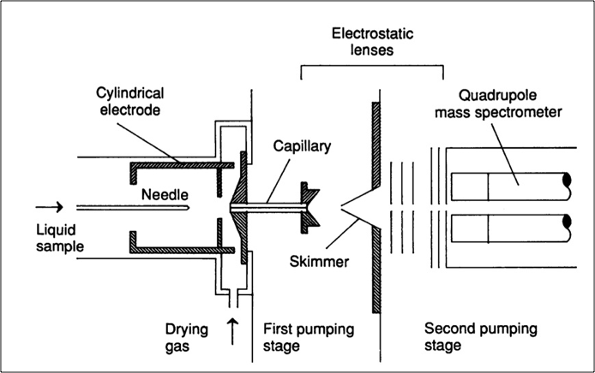
Espectrômetro de massas
Fonte: Fenn et al.
Notes:
Electrospray ionization for mass spectrometry of large biomolecules Fenn et. all. 1989
----- Meeting Notes (7/21/15 18:12) -----
Tirar o ponto

Slide 4
Introduction
SAMPLE
ION DETECTOR
2s

Slide 5
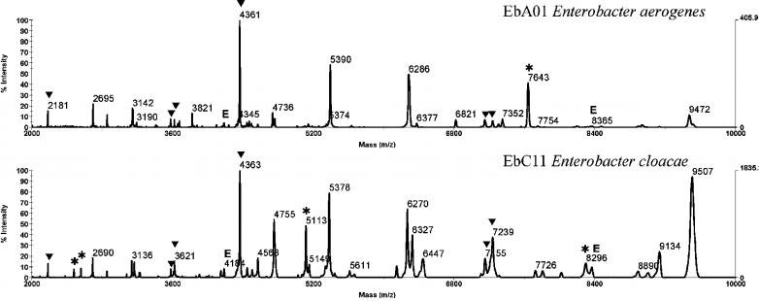
Espectrometria de Massas
Perfil de espectro de enterobactérias, separados por espécie.
Fonte: Adaptado de Böhme et al.

Slide 6
Introduction
Biological/MS Problems
Proteomic analysis
Blood serum proteomics analysis
Ovarian Cancer Diagnostic
Prostate Cancer Diagnostic
Breast Cancer Diagnostic
Intact cell analysis
Notes:
Proteomic Analysis
[4] - Arnold, R. J., Jayasankar, N., Aggarwal, D., Tang, H., & Radivojac, P. (2006). A machine learning approach to predicting peptide fragmentation spectra. Pacific Symposium on Biocomputing. Pacific Symposium on Biocomputing, 219–30.
Blood Serum proteomics analysis
[2] - Lilien, R. H., Farid, H., & Donald, B. R. (2003). Probabilistic Disease Classification of Expression-Dependent Proteomic Data from Mass Spectrometry of Human Serum. Journal of Computational Biology, 10(6), 925–946.
[5] - Conrads, T. P., Fusaro, V. a, Ross, S., Johann, D., Rajapakse, V., Hitt, B. a, … Veenstra, T. D. (2004). High-resolution serum proteomic features for ovarian cancer detection. Endocrine-Related Cancer, 11(2), 163–78.
[6] - Petricoin, E. F., Ardekani, A. M., Hitt, B. A., Levine, P. J., Fusaro, V. A., Steinberg, S. M., … Liotta, L. A. (2002). Use of proteomic patterns in serum to identify ovarian cancer. Lancet, 359, 572–577. doi:10.1016/S0140-6736(02)07746-2
[7] - Petricoin, E. F., Ornstein, D. K., Paweletz, C. P., Ardekani, A., Hackett, P. S., Hitt, B. a, … Liotta, L. a. (2002). Serum proteomic patterns for detection of prostate cancer. Journal of the National Cancer Institute
[28] - Li, J., Zhang, Z., Rosenzweig, J., Wang, Y. Y., & Chan, D. W. (2002). Proteomics and Bioinformatics Approaches for Identification of Serum Biomarkers to Detect Breast Cancer. Clinical Chemistry
Intact cell analysis
[3] - Böhme, K., Fernández-No, I. C., Barros-Velázquez, J., Gallardo, J. M., Carlo-Mata, P., & Cañas, B. (2010). Species differentiation of seafood spoilage and pathogenic gram-negative bacteria by MALDI-TOF mass fingerprinting. Journal of Proteome Research, 3169–3183.
[13] -Sauer, S., & Kliem, M. (2010). Mass spectrometry tools for the classification and identification of bacteria. Nature Reviews. Microbiology, 8(1), 74–82. doi:10.1038/nrmicro2243

Slide 7
Introduction
Artificial Intelligence
Statistics
Clustering
Neural Network
Evolutionary Algorithms

Slide 8
Introduction
Artificial Intelligence
Machine Learning
Random Forests
MLP
Clusters
Supervised
Unsupervised

Slide 9
Introduction
Mass Spectrometry Analysis
Mass Spectrometry
Raw Data
MS ANALYSIS
Peaks Processing
Peaks align
Smoothing
Re-shaping
Baseline correction
Pre-processing
Peaks Selection
Statistical Peaks Analysis
Neural Network
Cluster
Notes:
----- Meeting Notes (7/21/15 17:42) -----
Mudar as letras para preto

Slide 10
Open Source Software Packages for MS Analysis
Programs | Smooth | BaseLine Correction | Peaks Selection
Cromwell | Undecimated Discrete Wavelet Transform | Monotone minimum | SRN,Local maximum
LCMS-2D |  | Moving average of minima | SRN,Detection/Intensity threshold
LIMPIC | Kaiser window | Linear interpolation | SRN,Slopes of peaks
LMS | Gaussian filter | Linear interpolation | SRN,Local maximum
MapQuant | Moving average filter,Savitzky-Golay filter,Gaussian filter |  | Model-based criterion
CWT | Continuous Wavelet Transform | Continuous Wavelet Transform | SRN,Ridge lines
msInspect | Discrete Wavelet Transform | Linear interpolation,Loess | Shape ratio
mzMine | Moving average filter,Savitzky-Golay filter | Monotone minimum | SRN,Detection/Intensity threshold,Peak width
OpenMS | Continuous Wavelet Transform |  | Model-based criterion
PROcess | Moving average filter |  | SRN,Detection/Intensity threshold,Shape ratio
PreMS | Undecimated Discrete Wavelet Transform |  | SRN,Local maximum
XCMS | Gaussian filter |  | SRN,Local maximum
Adapted from: Comparison of public peak detection algorithms for MALDI mass spectrometry data analysis. (C. Yang et. al. 2009)

Slide 11
Introduction
Other Strategies and Software for
Peaks Alignment | Biomarker Analysis | Feature Extraction/Selection
icoshift | PCA ABC Genetic Algorithms | Correlation Statistics Counting

Slide 12
Introduction
Computational Problems
Different spectral resolutions
Tools
Different Approaches
Incompatibility of Tools

Slide 13
Motivation
The user friendly computational tools are lacking the capability of integrating all the steps in mass spectrometry data analysis.

Slide 14
General Objective
Propose an simple way to analysis mass spectrometry data using approaches such Artificial Intelligence,Automatic Feature Extraction and Statistical Analysis

Slide 15
Specifics
Create a MATLAB function library for mass spectrometry data analysis.
Run tests on public data proving the generic functionality in all data
Develop a simple interface to handle mass spectrometry data.
Publish a scientific article with the results generated with ML-MS Studio.
Release ML-MS Studio as open source software on SourceForge.
Objective | Status
MATLAB Library | Ok
Run Tests on public database | Ok
Develop GUI | Alpha Tests
Scientific Article | Working
Release as Open-Source | Last Version Release

Slide 16
Methods
Data Format
Peaks Selection
FMA – Fuzzy Moving Average
Feature Extraction
Best peaks Selection
Watch Points
Feature Resonance
Classification
Neural Network
PCA

Slide 17
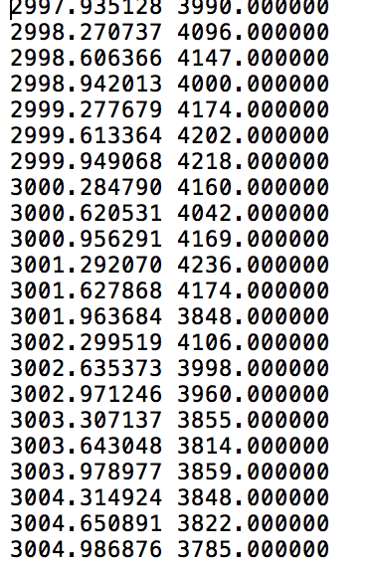
Data
Multiple Data Formats
MZML
Raw Data
M/Z
Intensity
Notes:
Diversos formatos
Padrão MZML
Não fazemos a conversão para raw data
Raw data formato Simples
Raw data menor do que o MZML

Slide 18
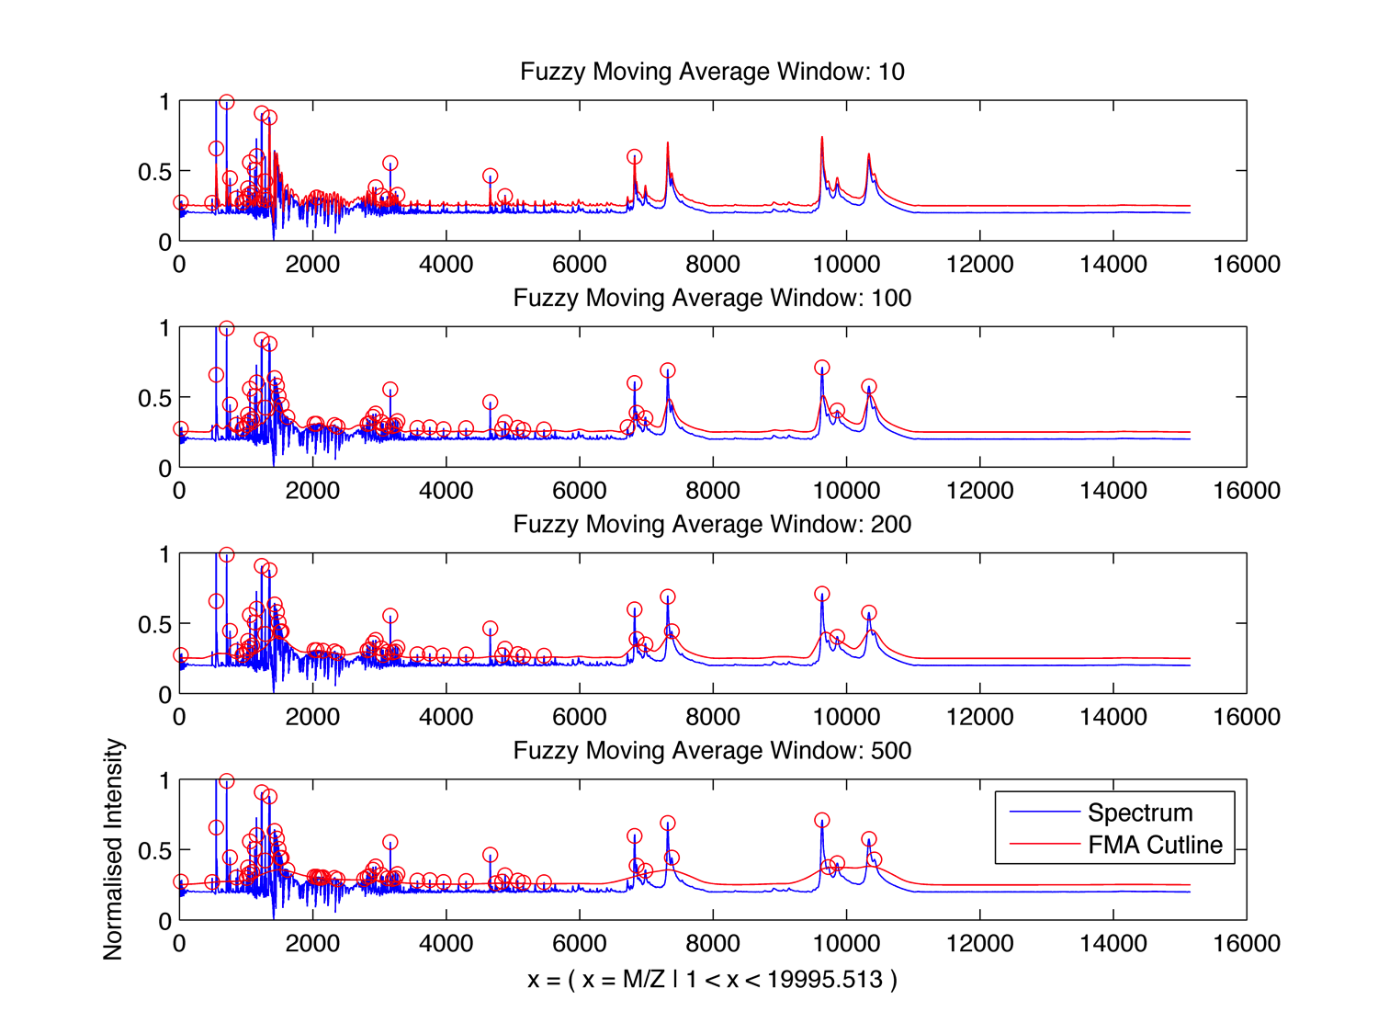
Peaks Selection with FMA.
Figure: Fuzzy Moving Average peaks selection, different window comparison (Author).

Slide 19
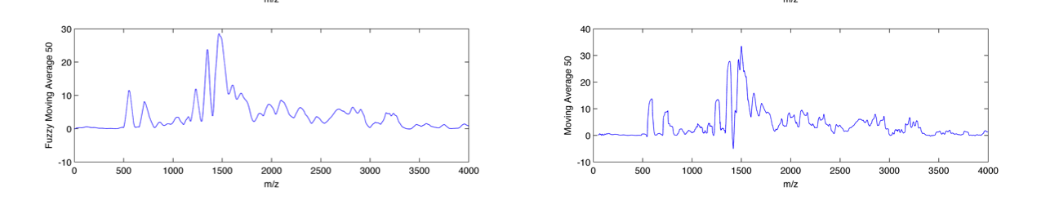
Why FMA?
1
2
Figure: Comparison smooth capability of FMA (1) and Moving average (2) (Author)

Slide 20
Automatic Feature Extraction
Feature Extractor | Approach
Watch Points | Fuzzy Logic Genetic Algorithm
Feature Resonance | Sinusoidal Waves Genetic Algorithm
Adapted Feature Extractor | Approach
Best Peaks Selection | Statistics

Slide 21
Automatic Feature Extraction
Variation | Description
Watch Points | Best Peaks Selection as Watch point Centers
Feature Resonance with Best Peaks | The best peaks selection are used as input
Feature Resonance with watch point | Peaks selected on the watch point are used as input
Feature Resonance with all M/Z values | Use all selected peaks m/z value as input
Feature Resonance with all intensity | Use all intensity values as input

Slide 22
GA - Genetic Algorithms
How to use?
Development of Fitness Function
Setup
Pros | Cons
Easy to implement Give simple programmatic way to resolve complex problems | Bad development of Fitness Bad Setup

Slide 23
Automatic Feature Extraction With GA
Best Correlation Driven Feature Extraction.
Mark A. Hall - Correlation Based Feature extraction for machine learning [15]
Over fitting
Cross Validation

Slide 24
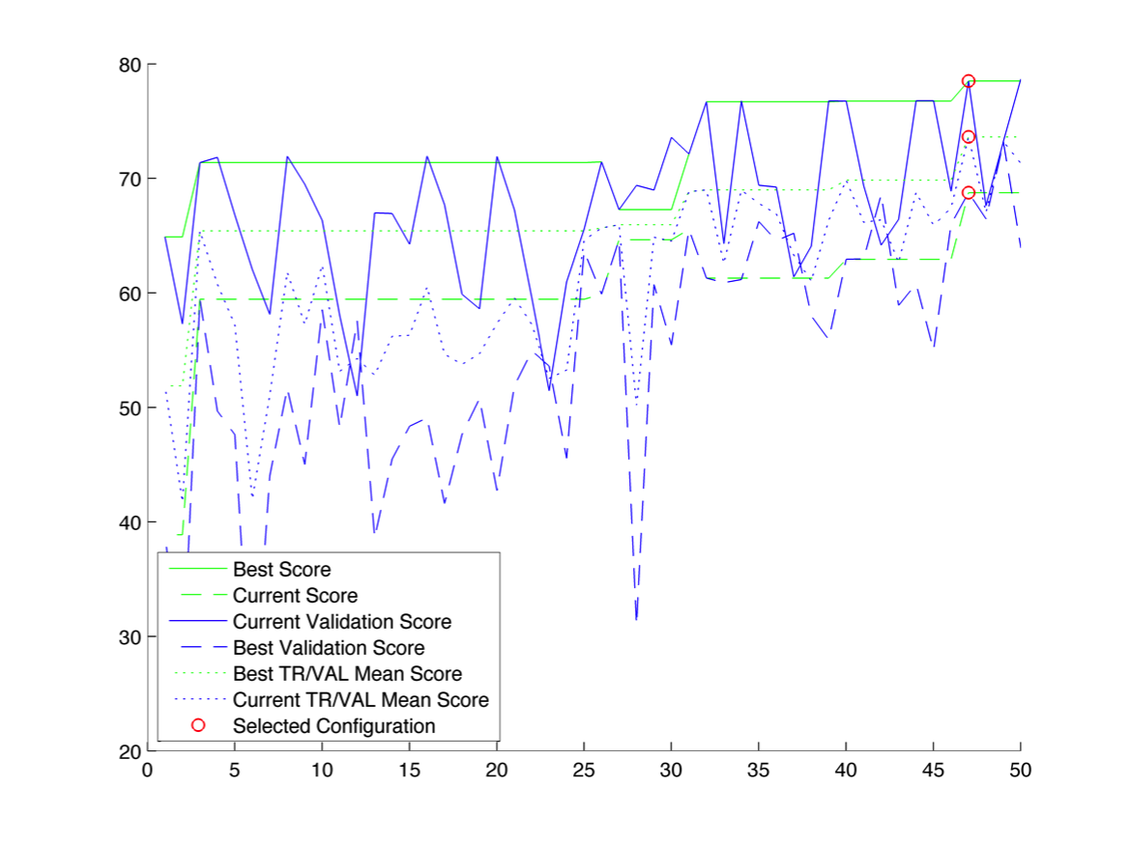
Cross Validation Performance

Slide 25
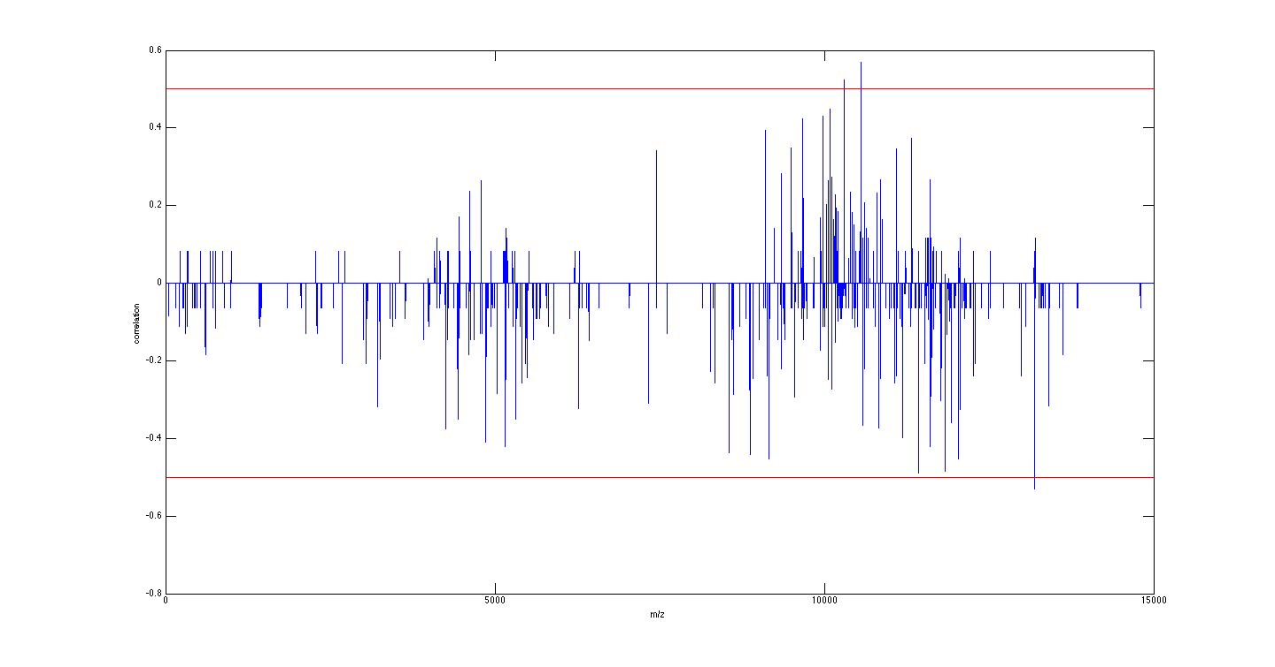
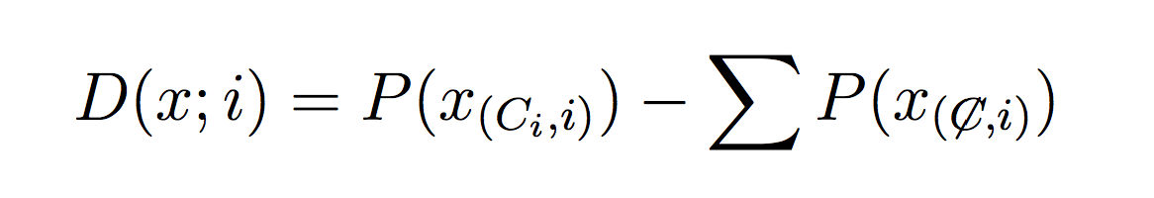
Best Peaks Selection
Correlation approach
Probability Approach

Slide 26
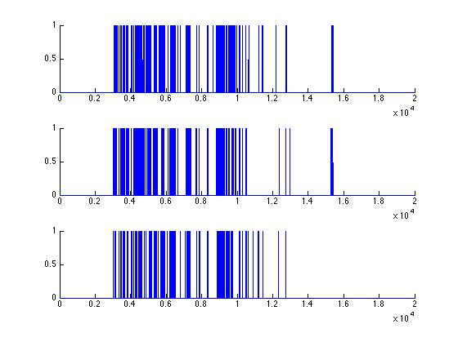
Best Peaks Selection
Figure: three different E. Coli sub-species Barcode Spectrum ( Author )

Slide 27
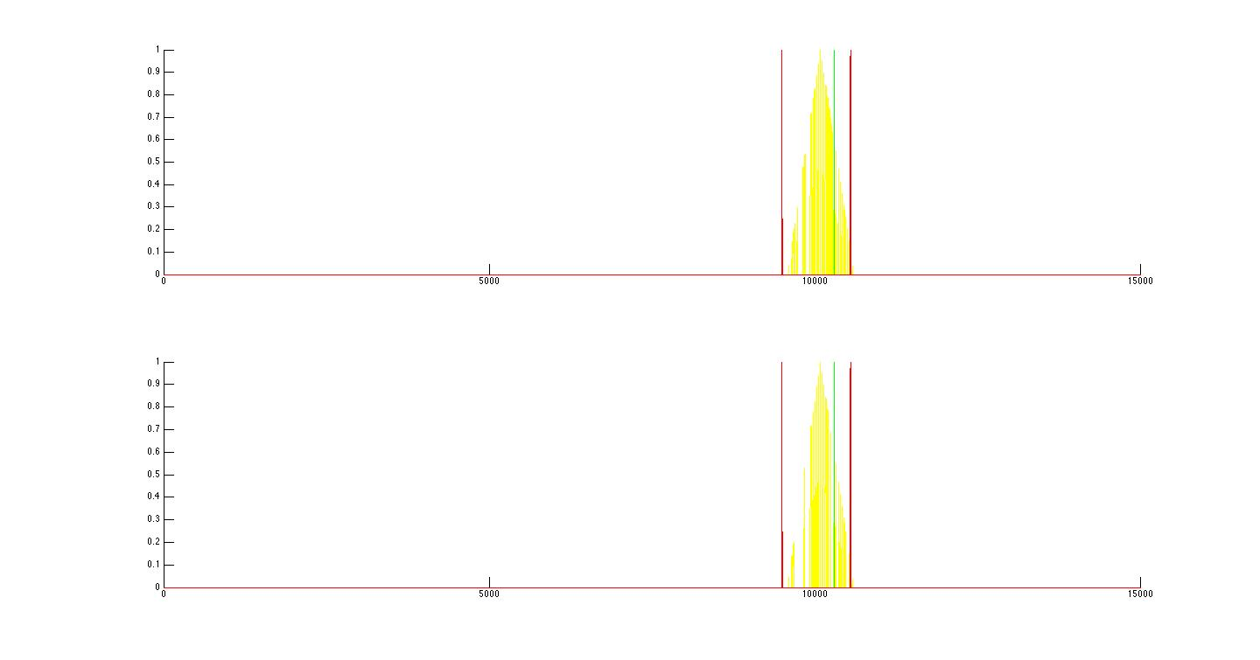
Watch Points
1
2
Figure: Watch points reveal lacking information between two set of samples on peak neighbor analysis (Author)

Slide 28
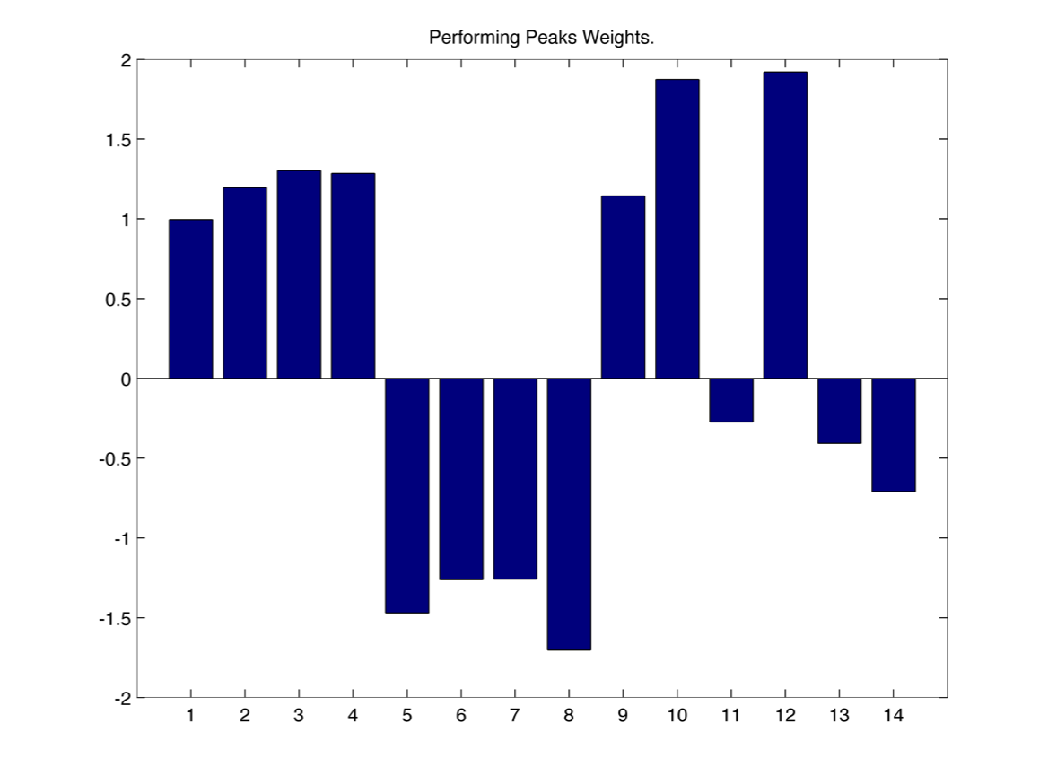
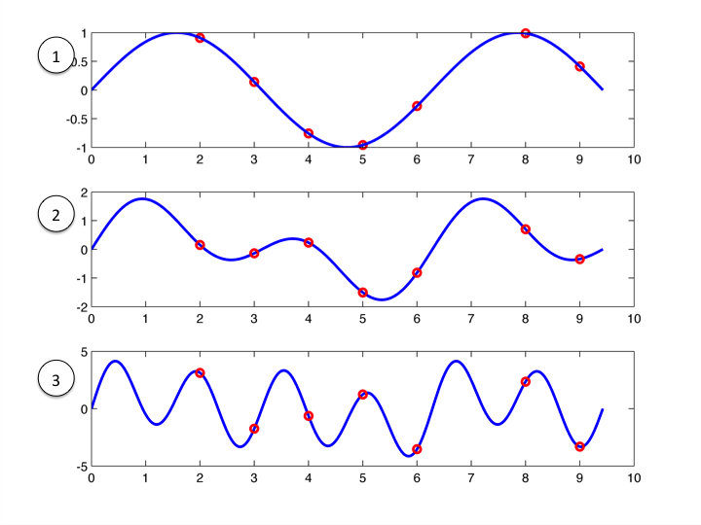
Feature Resonance
Sum of Sinusoidal Waves.
Best Peaks Selection
Figure: Example FR weights from sinusoidal
Functions (Author )
Figure: Sample sinusoidal waves and positions ( Author )
Notes:
----- Meeting Notes (7/21/15 17:42) -----
verificar espaços e pontos

Slide 29
Results
Ovarian Cancer
National Cancer Institute (USA)
Prostate Cancer
National Cancer Institute (USA)
Microorganisms
Data Provided by: Departamento de Patologia Médica, Universidade Federal do Paraná, Brasil
Library And Software

Slide 30
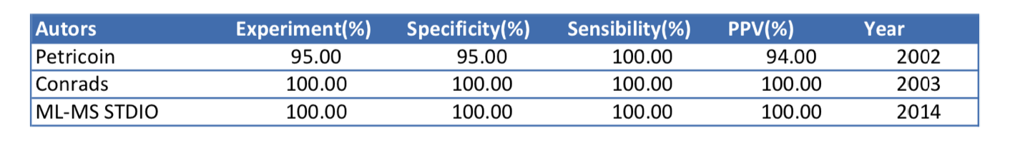
Ovarian Cancer Results
Resolution: | From: 360K to 15K
Watch Points with Best Peaks | Correlation threshold: 0.3 Cycles: 100
Best Peaks | Correlation threshold: 0.3 Correlation threshold: 0.2
Feature Resonance with Best Peaks | Correlation threshold: 0.3 Cycles: 100 Waves: 20
Feature Resonance with Watch Points | Cycles: 100
Results Comparison

Slide 31
Prostate Cancer Results
Resolution: | From: 360K to 15K
Feature resonance with All intensity | Cycles: 100
Feature Resonance with Best Peaks | Correlation threshold: 0.19, 0.2, 0.21 and 0.22 Waves: 10 Cycles: 100
Results Comparison
Study | Precision | Accuracy
MS-ML Studio | 100% | 0.9
Petricoin et al. | 100% | -

Slide 32
Intact Cell Results
Aeromonas
A. Hidrophilla
A. Cavie
A. Trota
A. Veroni Sobria
Objective Class Against the Others
Notes:
----- Meeting Notes (7/21/15 17:42) -----
Italico
verificar os nomes .

Slide 33
Intact Cell Results
A. Hidrophilla Feature Resonance with Best Peaks | Correlation threshold: 0.12, 0.15 and 0.16 Waves: 10 Cycles: 10
A. Cavie Feature Resonance with Best Peaks | Correlation threshold: 0.12, 0.16 and 0.20 Waves: 10 Cycles: 10
A. Trota Feature Resonance with Best Peaks | Correlation threshold: 0.12, 0.20 and 0.40 Waves: 10 Cycles: 10
A. Veroni/Sobria Feature Resonance with Best Peaks | Correlation threshold: 0.12, 0.16, 0.2 and 0.25 Waves: 10 Cycles: 10
Notes:
----- Meeting Notes (7/21/15 17:42) -----
Nome em italico

Slide 34
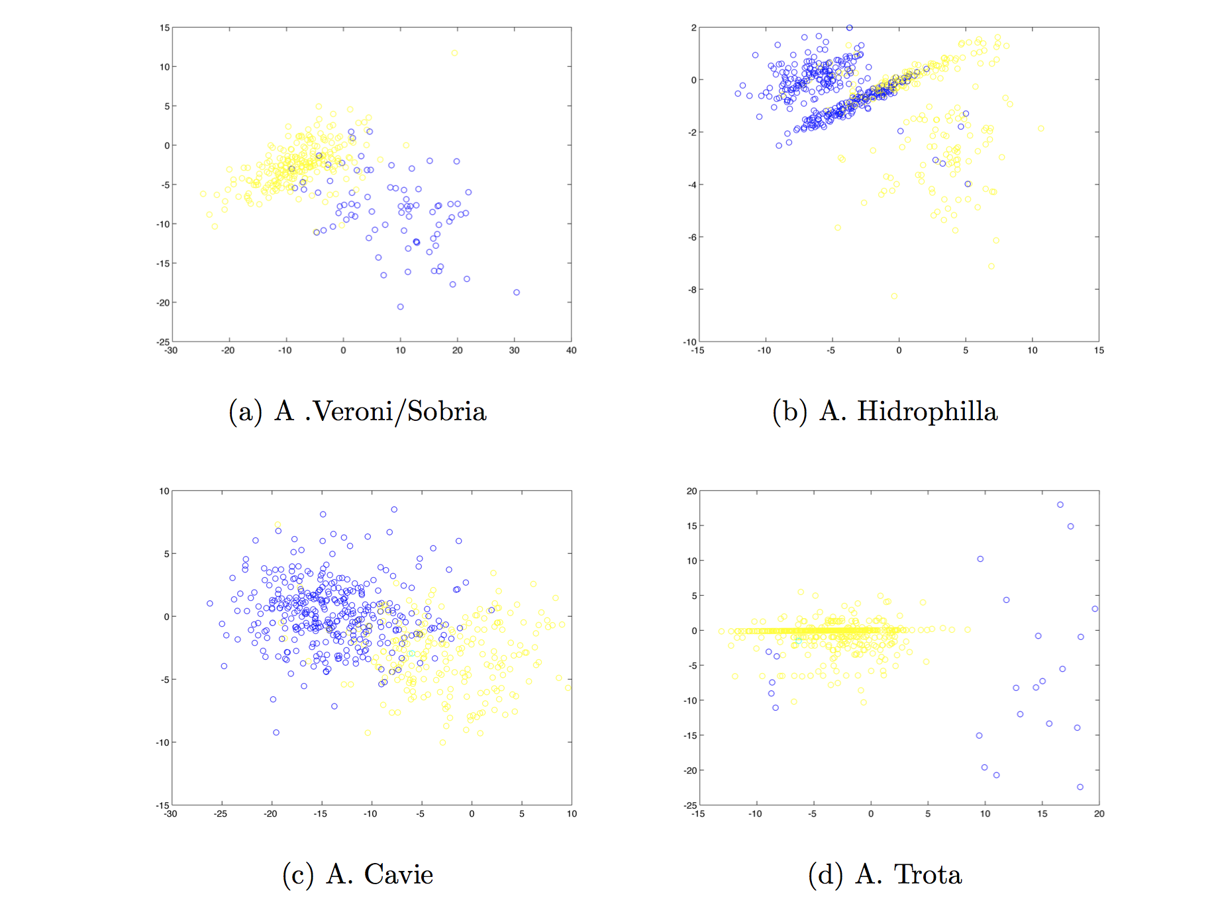
Intact Cell Results
Experiments reach classification scores from 90% to 100% of precision in all experiments.
Notes:
----- Meeting Notes (7/21/15 15:02) -----
Todos os casos

Slide 35
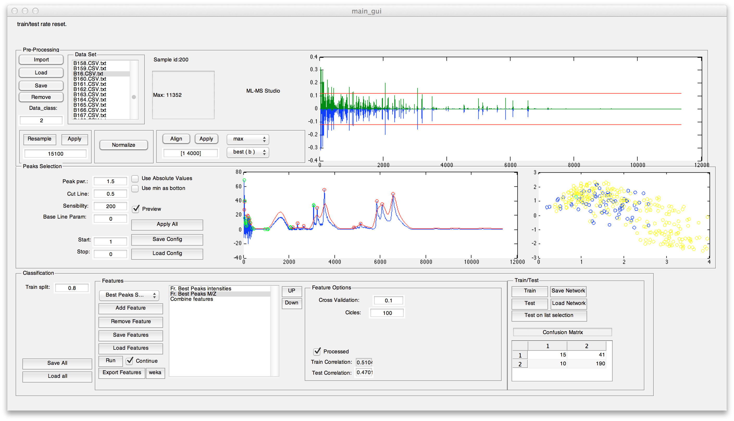
Library And Software
Notes:
----- Meeting Notes (7/21/15 17:42) -----
Jogar ela Pra

Slide 36
Conclusion and Future Work
Generic Cases
Retest all data with last program version
Create import procedures to handle other data format.
Notes:
----- Meeting Notes (7/21/15 17:56) -----
Criar um novo slide para apresentar aquisição do software e repositório.

Slide 37
Agradecimentos
PPG Bioinformática UFPR
Casadinho/PROCAD
Professores:
Dr. Roberto T. Raittz.
Dr. Luciano Huergo.
Cyntia M. T. Fadel Picheth
Capes
Colegas
Cibelle Dalagassa
Aniele Leão
Flavia Costa
Notes:
----- Meeting Notes (7/21/15 17:56) -----
Dr Luciano Huergo
Tirar CNPQ, Reuni.

Slide 38
References
Krishnamurthy, T., & Ross, P. L. (1996). Rapid identification of bacteria by direct matrix-assisted laser desorption/ionization mass spectrometric analysis of whole cells. Rapid Communications in Mass Spectrometry : RCM, 10(15), 1992–6. doi:10.1002/(SICI)1097-0231(199612)10:15<1992::AID-RCM789>3.0.CO;2-V
Lilien, R. H., Farid, H., & Donald, B. R. (2003). Probabilistic Disease Classification of Expression-Dependent Proteomic Data from Mass Spectrometry of Human Serum. Journal of Computational Biology, 10(6), 925–946.
Böhme, K., Fernández-No, I. C., Barros-Velázquez, J., Gallardo, J. M., Carlo-Mata, P., & Cañas, B. (2010). Species differentiation of seafood spoilage and pathogenic gram-negative bacteria by MALDI-TOF mass fingerprinting. Joural of Proteome Research, 3169–3183. Retrieved from http://pubs.acs.org/doi/abs/10.1021/pr100047q

Slide 39
References
Arnold, R. J., Jayasankar, N., Aggarwal, D., Tang, H., & Radivojac, P. (2006). A machine learning approach to predicting peptide fragmentation spectra. Pacific Symposium on Biocomputing. Pacific Symposium on Biocomputing, 219–30. Retrieved from http://www.ncbi.nlm.nih.gov/pubmed/17094241
Conrads, T. P., Fusaro, V. a, Ross, S., Johann, D., Rajapakse, V., Hitt, B. a, … Veenstra, T. D. (2004). High-resolution serum proteomic features for ovarian cancer detection. Endocrine-Related Cancer, 11(2), 163–78. Retrieved from http://www.ncbi.nlm.nih.gov/pubmed/15163296
Petricoin, E. F., Ardekani, A. M., Hitt, B. A., Levine, P. J., Fusaro, V. A., Steinberg, S. M., … Liotta, L. A. (2002). Use of proteomic patterns in serum to identify ovarian cancer. Lancet, 359, 572–577. doi:10.1016/S0140-6736(02)07746-2

Slide 40
References
Petricoin, E. F., Ornstein, D. K., Paweletz, C. P., Ardekani, A., Hackett, P. S., Hitt, B. a, … Liotta, L. a. (2002). Serum proteomic patterns for detection of prostate cancer. Journal of the National Cancer Institute, 94(20), 1576–1578. doi:10.1093/jnci/94.20.1576
Liu, Y., Aickelin, U., Feyereisl, J., & Durrant, L. G. (2013). Wavelet feature extraction and genetic algorithm for biomarker detection in colorectal cancer data. Knowledge-Based Systems, 37, 502–514. doi:10.1016/j.knosys.2012.09.011
Tomasi, G., Savorani, F., & Engelsen, S. B. (2011). Icoshift: An effective tool for the alignment of chromatographic data. Journal of Chromatography A, 1218(43), 7832–7840. doi:10.1016/j.chroma.2011.08.086
Armananzas, R., Saeys, Y., Inza, I., Garcia-Torres, M., Bielza, C., Peer, Y. Van De, & Larranaga, P. (2011). Peakbin Selection in Mass Spectrometry Data Using a Consensus Approach with Estimation of Distribution Algorithms. IEEE/ACM Transactions on Computational Biology and Bioinformatics, 8(3), 760–774. doi:10.1109/TCBB.2010.18

Slide 41
References
Lasch, P., Beyer, W., Nattermann, H., Stämmler, M., Siegbrecht, E., Grunow, R., & Naumann, D. (2009). Identification of Bacillus anthracis by using matrix-assisted laser desorption ionization-time of flight mass spectrometry and artificial neural networks. Applied and Environmental Microbiology, 75(22), 7229–42. doi:10.1128/AEM.00857-09
Fenn, J. J. B., Mann, M., Meng, C. K. a I. C., Wong, S. F., & Whitehouse, C. M. (1989). Electrospray ionization for mass spectrometry of large biomolecules. Science, 246(6), 64–71. Retrieved from http://www.sciencemag.org/content/246/4926/64.short
Sauer, S., & Kliem, M. (2010). Mass spectrometry tools for the classification and identification of bacteria. Nature Reviews. Microbiology, 8(1), 74–82. doi:10.1038/nrmicro2243

Slide 42
References
Syarifahadilah, M. Y., Abdullah, R., & Venkat, I. (2012). ABC algorithm as feature selection for biomarker discovery in mass spectrometry analysis. Conference on Data Mining and Optimization, (September), 67–72. doi:10.1109/DMO.2012.6329800
Hall, M. a. (1999). Correlation-based Feature Selection for Machine Learning Methodology. Doctor of Philosophy thesis at The University of Waikato. Hamilton, New Zeland.
Marchiori, E., Jimenez, C. R., West-Nielsen, M., & Heegaard, N. H. H. (2006). Robust SVM-based biomarker selection with noisy mass spectrometric proteomic data. Lecture Notes in Computer Science (including Subseries Lecture Notes in Artificial Intelligence and Lecture Notes in Bioinformatics), 3907 LNCS, 79–90. doi:10.1007/11732242_8

Slide 43
References
Renard, B. Y., Kirchner, M., Steen, H., Steen, J. a J., & Hamprecht, F. a. (2008). NITPICK: peak identification for mass spectrometry data. BMC Bioinformatics, 9, 355. doi:10.1186/1471-2105-9-355
Yang, C., He, Z., & Yu, W. (2009). Comparison of public peak detection algorithms for MALDI mass spectrometry data analysis. BMC Bioinformatics, 10, 4. doi:10.1186/1471-2105-10-4
Liu, Y. (2009). Feature extraction and dimensionality reduction for mass spectrometry data. Computers in Biology and Medicine, 39(9), 818–823. doi:10.1016/j.compbiomed.2009.06.012
Morris, J. S., Coombes, K. R., Koomen, J., Baggerly, K. a., & Kobayashi, R. (2005). Feature extraction and quantification for mass spectrometry in biomedical applications using the mean spectrum. Bioinformatics, 21(9), 1764–1775. doi:10.1093/bioinformatics/bti254

Slide 44
References
De Bruyne, K., Slabbinck, B., Waegeman, W., Vauterin, P., De Baets, B., & Vandamme, P. (2011). Bacterial species identification from MALDI-TOF mass spectra through data analysis and machine learning. Systematic and Applied Microbiology, 34(1), 20–29. doi:10.1016/j.syapm.2010.11.003
Lilien, R. H., Farid, H., & Donald, B. R. (2003). Probabilistic Disease Classification of Expression-Dependent Proteomic Data from Mass Spectrometry of Human Serum. Journal of Computational Biology, 10(6), 925–946.
Wagner, M., Naik, D., & Pothen, A. (2003). Protocols for disease classification from mass spectrometry data. Proteomics, 3(SEPTEMBER 2003), 1692–1698. doi:10.1002/pmic.200300519
Jarman, K. H., Cebula, S. T., Saenz, a J., Petersen, C. E., Valentine, N. B., Kingsley, M. T., & Wahl, K. L. (2000). An algorithm for automated bacterial identification using matrix-assisted laser desorption/ionization mass spectrometry. Analytical Chemistry, 72(6), 1217–23. Retrieved from http://www.ncbi.nlm.nih.gov/pubmed/10740862

Slide 45
References
Tibshirani, R., Hastie, T., Narasimhan, B., Soltys, S., Shi, G., Koong, A., & Le, Q.-T. (2004). Sample classification from protein mass spectrometry, by “peak probability contrasts”. Bioinformatics (Oxford, England), 20(17), 3034–44. doi:10.1093/bioinformatics/bth357
Yu, J. S., Ongarello, S., Fiedler, R., Chen, X. W., Toffolo, G., Cobelli, C., & Trajanoski, Z. (2005). Ovarian cancer identification based on dimensionality reduction for high-throughput mass spectrometry data. Bioinformatics, 21(10), 2200–2209. doi:10.1093/bioinformatics/bti370
Conrads, T. P., Zhou, M., Petricoin, E. F., Liotta, L., & Veenstra, T. D. (2003). Cancer diagnosis using proteomic patterns. Expert Review of Molecular Diagnostics, 3, 411–420. doi:10.1586/14737159.3.4.411
Li, J., Zhang, Z., Rosenzweig, J., Wang, Y. Y., & Chan, D. W. (2002). Proteomics and Bioinformatics Approaches for Identification of Serum Biomarkers to Detect Breast Cancer. Clinical Chemistry, 1304, 1296–1304.

